Slide 1
Support Vector Machine (SVM)
Lin zhang
Sse, tongji university
Sep. 2016

Slide 2
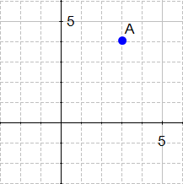
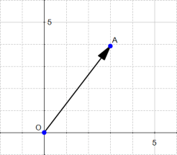

What is a vector?
SVM = Support VECTOR Machine
If we define a point A(3,4) in $ℝ^{2}$ we can plot it like this.
There exists a vector between the origin and A.

Slide 3
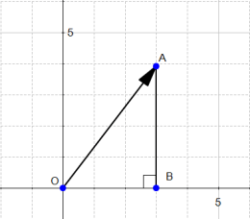

The magnitude of a vector
The magnitude or length of a vector x is written $\left\|x\right\|$and is called its norm

Slide 4
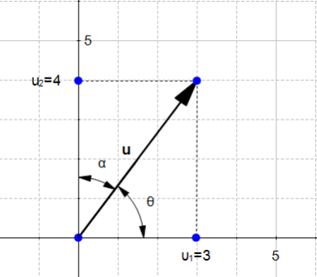
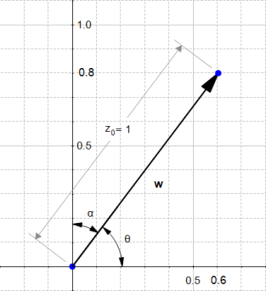


The direction of a vector
The direction of a vector u=(u₁,u₂) is the vector w=($\frac{u_{1}}{\left\|u\right\|},\frac{u_{2}}{\left\|u\right\|}$)
$$\cos\left(θ\right)=\frac{u_{1}}{\left\|u\right\|}=\frac{3}{5}=0.6$$
$$\cos\left(α\right)=\frac{u_{2}}{\left\|u\right\|}=\frac{4}{5}=0.8$$

Slide 5
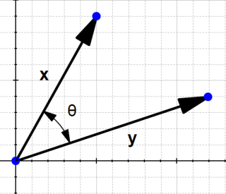
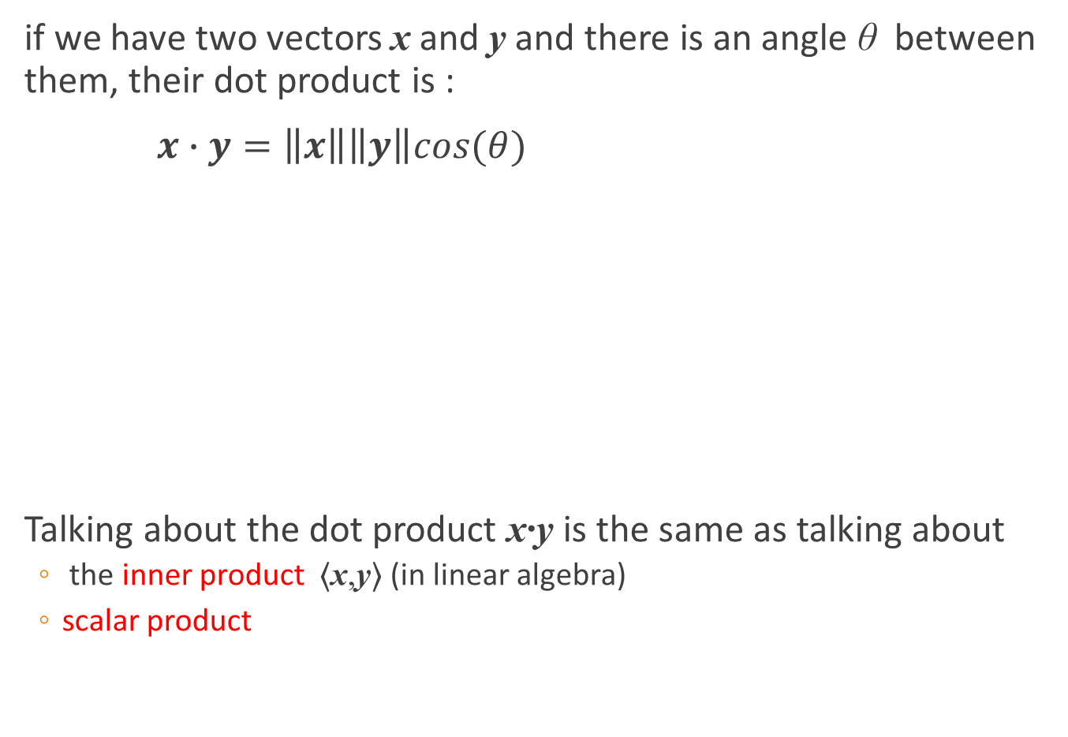
The dot product
if we have two vectors x and y and there is an angle θ between them, their dot product is :
$x∙y=\left\|x\right\|\left\|y\right\|cos⁡(θ)$
Talking about the dot product x∙y is the same as talking about
the inner product ⟨x,y⟩ (in linear algebra)
scalar product

Slide 6
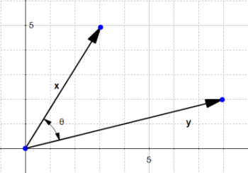
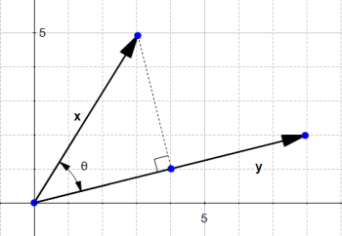
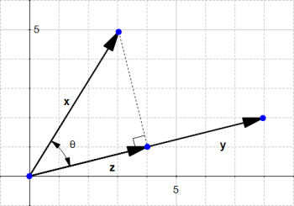
The orthogonal projection of a vector
Given two vectors x and y, we would like to find the orthogonal projection of x onto y.
To do this we project the vector x onto y
This give us the vector z

Slide 7
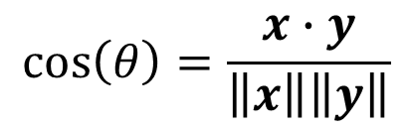
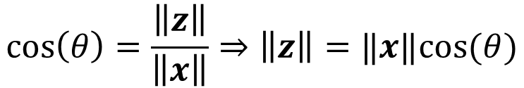
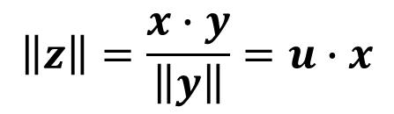

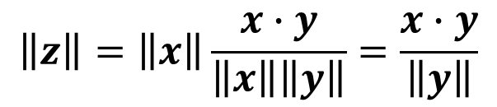
The orthogonal projection of a vector
By definition
We have
If we define the vector u as the direction of y then
$$\cos\left(θ\right)=\frac{\left\|z\right\|}{\left\|x\right\|}⇒\left\|z\right\|=‖x‖cos⁡(θ)$$
$$\cos\left(θ\right)=\frac{x∙y}{\left\|x\right\|\left\|y\right\|}$$
$$\left\|z\right\|=\left\|x\right\|\frac{x∙y}{\left\|x\right\|\left\|y\right\|}=\frac{x∙y}{\left\|y\right\|}$$
$$u=\frac{y}{\left\|y\right\|}$$
$$\left\|z\right\|=\frac{x∙y}{\left\|y\right\|}=u∙x$$

Slide 8
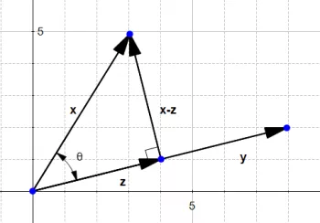
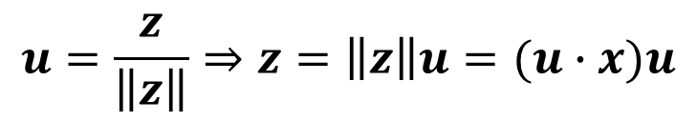
The orthogonal projection of a vector
Since this vector is in the same direction as y, it has the direction u
It allows us to compute the distance between x and the line which goes through y
$$u=\frac{z}{\left\|z\right\|}⇒z=\left\|z\right\|u=(u∙x)u$$

Slide 9
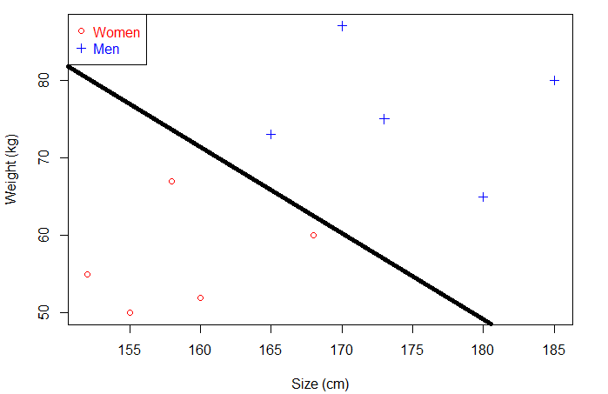
What is a separating hyperplane?
We could trace a line and then all the data points representing men will be above the line, and all the data points representing women will be below the line.
Such a line is called a separating hyperplane, or a decision boundary

Slide 10

What is a separating hyperplane?
An hyperplane is a generalization of a plane.
in one dimension, an hyperplane is called a point
in two dimensions, it is a line
in three dimensions, it is a plane
in more dimensions you can call it an hyperplane

Slide 11
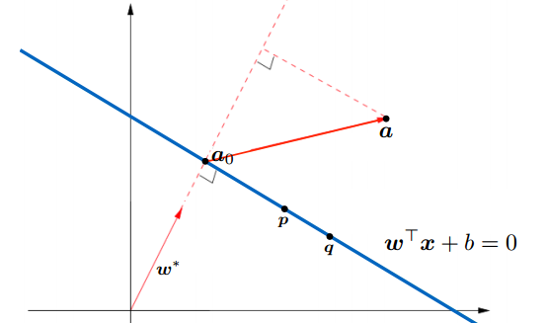

Compute signed distance from a point to the hyperplane
We have an hyperplane, which separates two groups of data
The equation of the hyperplane is $w^{T}x+b=0$
$w^{∗}=\frac{w}{\left\|w\right\|}$ is the unit normal vector
We would like to compute the distance between the point a and the hyperplane

Slide 12

Compute signed distance from a point to the hyperplane
We want to find distance between a and line in direction of $w^{∗}$
If we define point a₀ on the line, then this distance corresponds to length of $a−a_{0}$ in direction of $w^{∗}$ , which equals ${w^{∗}}^{T}(a−a_{0})$
Since $w^{T}a_{0}=−b$, the distance equals $\frac{1}{\left\|w\right\|}(w^{T}a+b)$

Slide 13
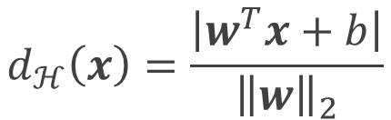
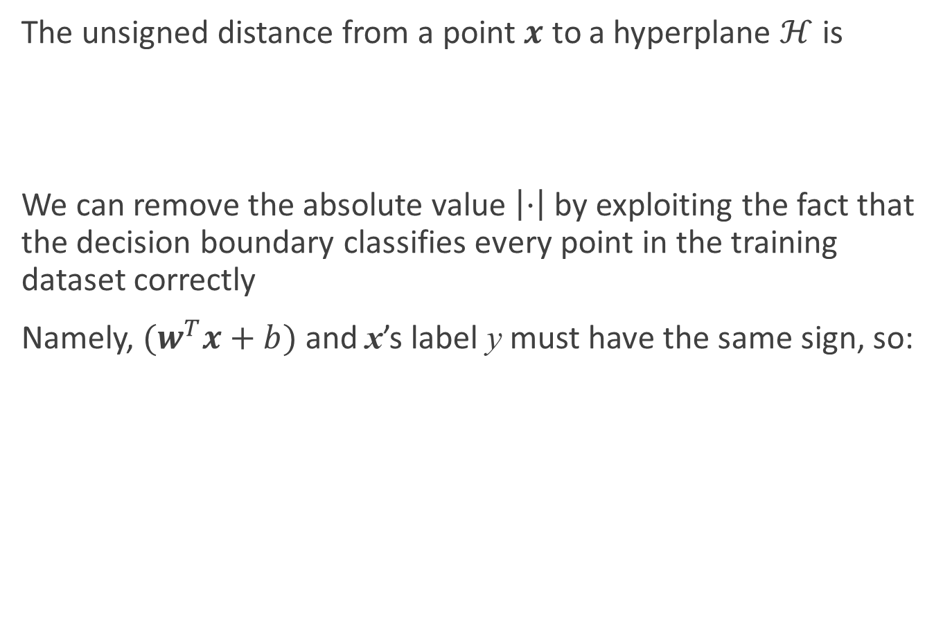
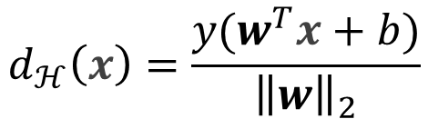
Distance from a point to decision boundary
The unsigned distance from a point $x$ to a hyperplane $ℋ$ is
We can remove the absolute value $\left|⋅\right|$ by exploiting the fact that the decision boundary classifies every point in the training dataset correctly
Namely, $(w^{T}x+b)$ and x’s label y must have the same sign, so:
$$d_{ℋ}\left(x\right)=\frac{\left|w^{T}x+b\right|}{{\left\|w\right\|}_{2}}$$
$$d_{ℋ}\left(x\right)=\frac{y(w^{T}x+b)}{{\left\|w\right\|}_{2}}$$

Slide 14
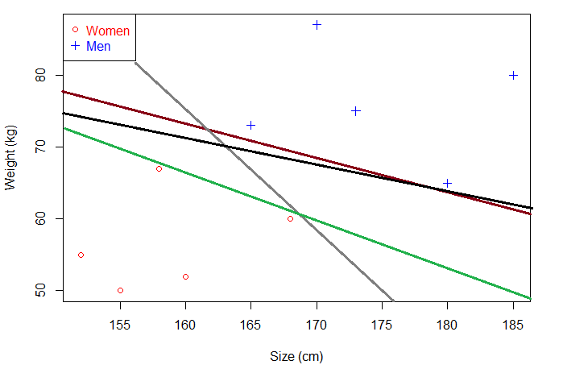
Intuition: where to put the decision boundary?
In the example below there are several separating hyperplanes. Each of them is valid as it successfully separates our data set with men on one side and women on the other side.
There can be a lot of separating hyperplanes

Slide 15
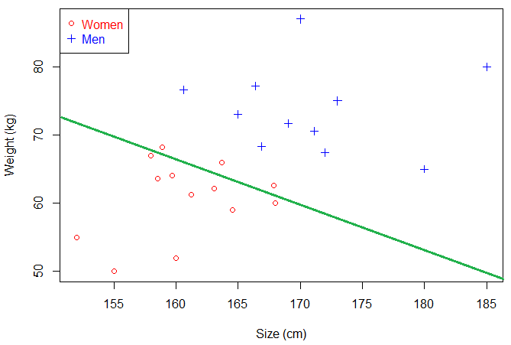
Intuition: where to put the decision boundary?
Suppose we select the green hyperplane and use it to classify on real life data
This hyperplane does not generalize well
Notes:
This time, it makes some mistakes as it wrongly classify three women. Intuitively, we can see that if we select an hyperplane which is close to the data points of one class, then it might not generalize well.

Slide 16
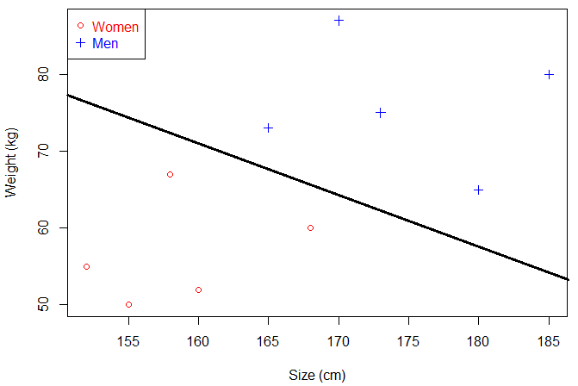
Intuition: where to put the decision boundary?
So we will try to select an hyperplane as far as possible from data points from each category:
This one looks better.

Slide 17
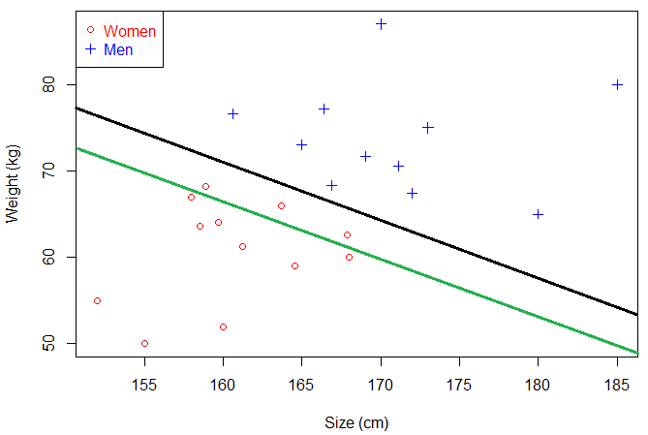
Intuition: where to put the decision boundary?
When we use it with real life data, we can see it still make perfect classification.
The black hyperplane classifies more accurately than the green one

Slide 18
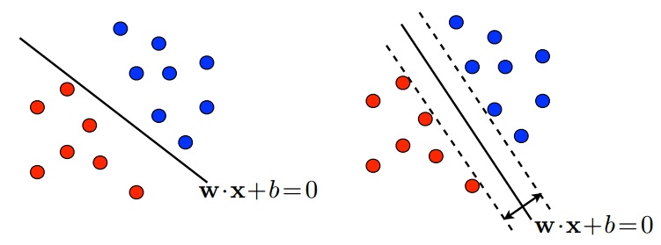
Intuition: where to put the decision boundary?
That's why the objective of a SVM is to find the optimal separating hyperplane:
because it correctly classifies the training data
and because it is the one which will generalize better with unseen data
Idea: Find a decision boundary in the ‘middle’ of the two classes. In other words, we want a decision boundary that:
Perfectly classifies the training data
Is as far away from every training point as possible

Slide 19
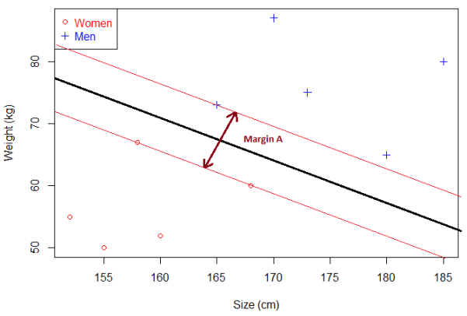
What is the margin?
Given a particular hyperplane, we can compute the distance between the hyperplane and the closest data point. Once we have this value, if we double it we will get what is called the margin.
The margin of our optimal hyperplane

Slide 20
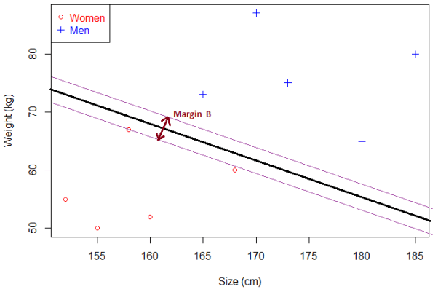
What is the margin?
There will never be any data point inside the margin
Note: this can cause some problems when data is noisy, and this is why soft margin classifier will be introduced later
For another hyperplane, the margin will look like this:
Margin B is smaller than Margin A.

Slide 21
The hyperplane and the margin
We can make the following observations:
If a hyperplane is very close to a data point, its margin will be small.
The further a hyperplane is from a data point, the larger its margin will be.
This means that the optimal hyperplane will be the one with the biggest margin.
That is why the objective of the SVM is to find the optimal separating hyperplane which maximizes the margin of the training data.

Slide 22
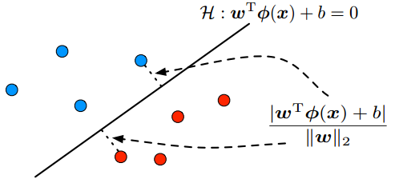

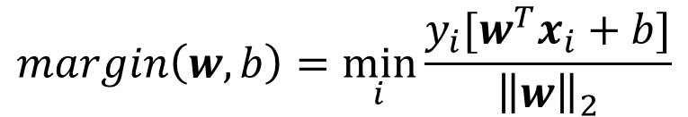

Optimizing the Margin
Margin is the smallest distance between the hyperplane and all training points
$$margin\left(w,b\right)=\min_{i}{\frac{y_{i}[w^{T}x_{i}+b]}{{\left\|w\right\|}_{2}}}$$
How should we pick $\left(w,b\right)$ based on its margin?

Slide 23
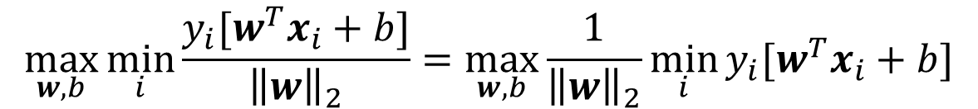
Optimizing the Margin
We want a decision boundary that is as far away from all training points as possible, so we have to maximize the margin!
$$\max_{w,b}{\min_{i}{\frac{y_{i}[w^{T}x_{i}+b]}{{\left\|w\right\|}_{2}}=\max_{w,b}{\frac{1}{{\left\|w\right\|}_{2}}\min_{i}{y_{i}[w^{T}x_{i}+b]}}}}$$

Slide 24
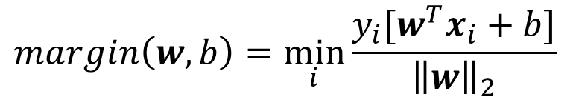
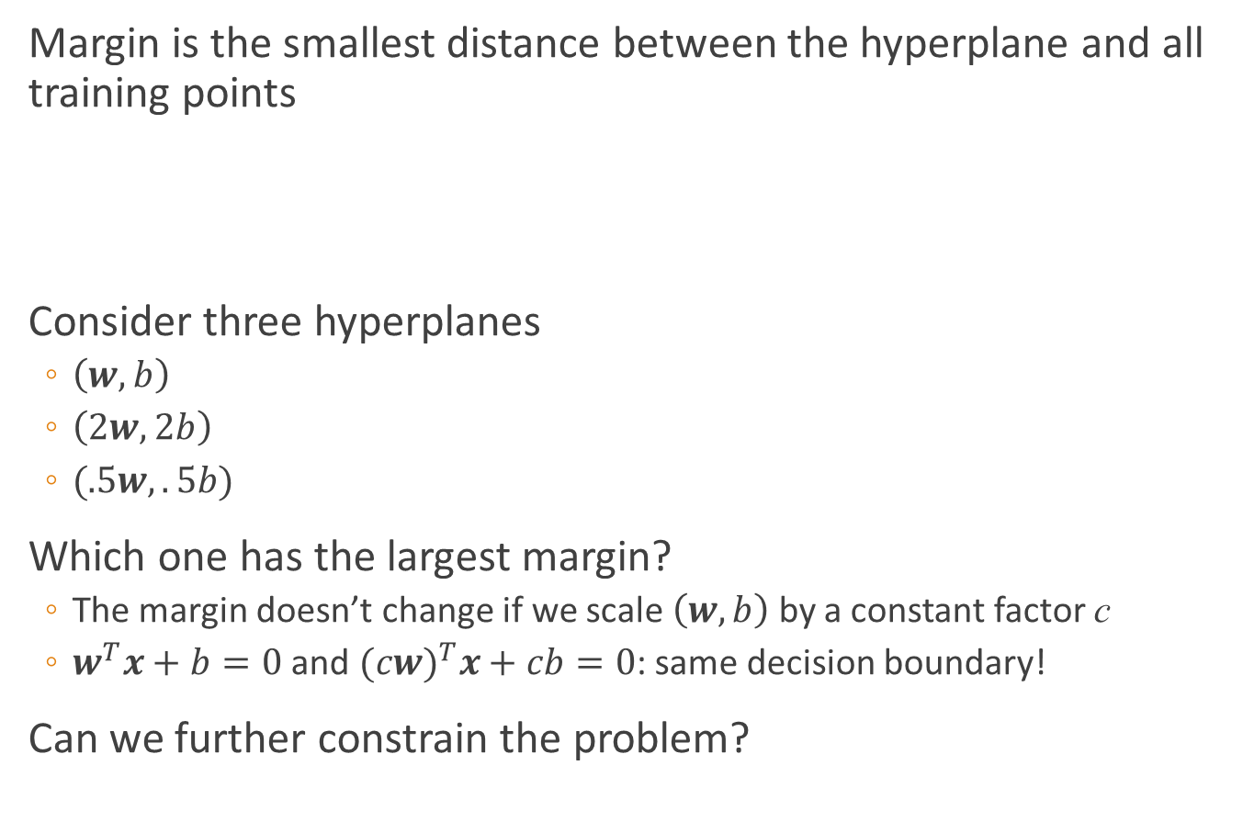
Optimizing the Margin
Margin is the smallest distance between the hyperplane and all training points
Consider three hyperplanes
$\left(w,b\right)$
$\left(2w,2b\right)$
$(.5w,.5b)$
Which one has the largest margin?
The margin doesn’t change if we scale $\left(w,b\right)$ by a constant factor c
$w^{T}x+b=0$ and ${(cw)}^{T}x+cb=0$: same decision boundary!
Can we further constrain the problem?
$$margin\left(w,b\right)=\min_{i}{\frac{y_{i}[w^{T}x_{i}+b]}{{\left\|w\right\|}_{2}}}$$

Slide 25
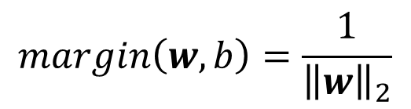
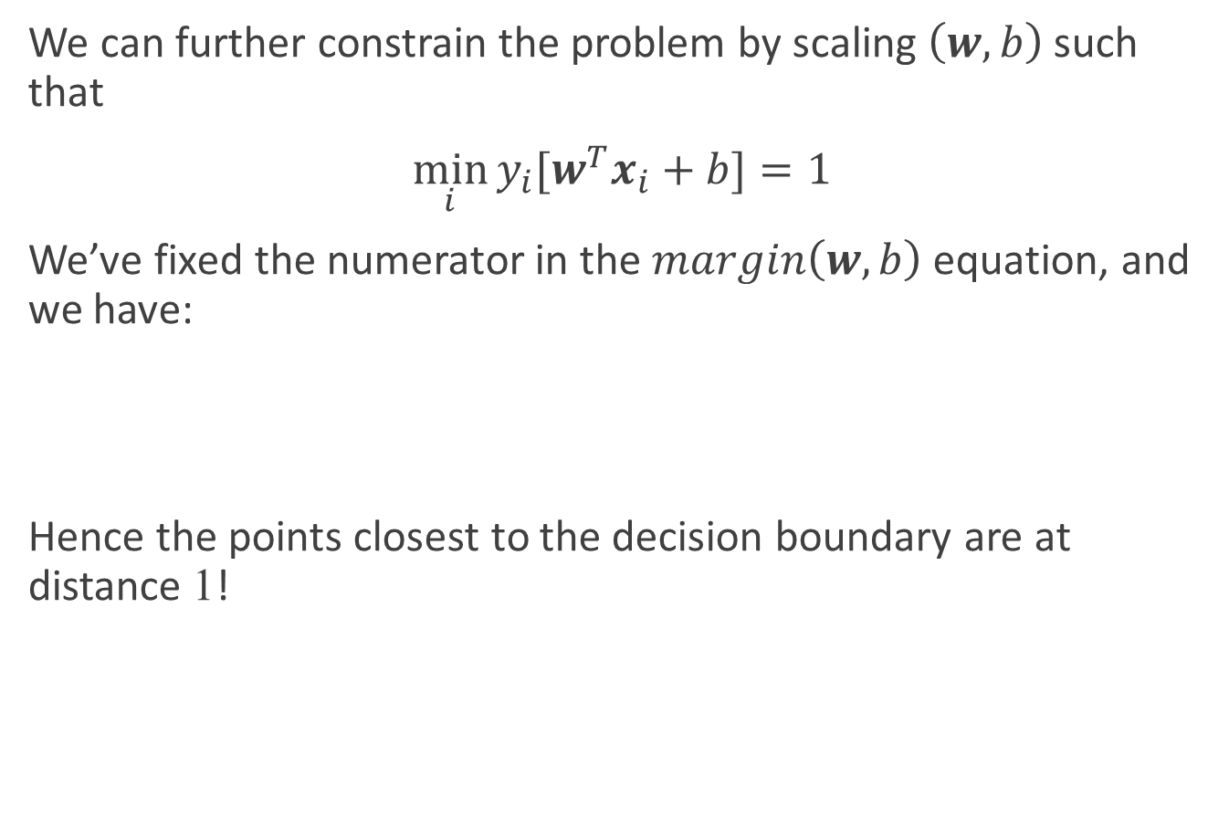
Rescaled Margin
We can further constrain the problem by scaling $\left(w,b\right)$ such that
$\min_{i}{y_{i}[w^{T}x_{i}+b]}=1$
We’ve fixed the numerator in the $margin\left(w,b\right)$ equation, and we have:
Hence the points closest to the decision boundary are at distance 1!
$$margin\left(w,b\right)=\frac{1}{{\left\|w\right\|}_{2}}$$

Slide 26
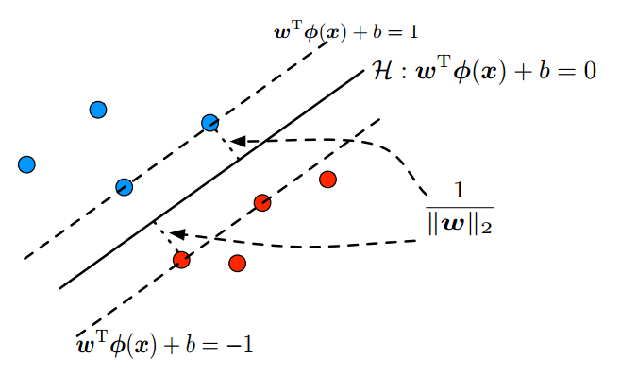
Rescaled Margin

Slide 27
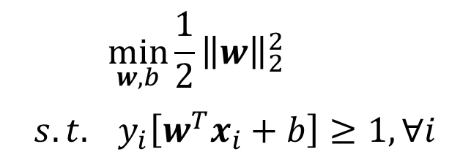
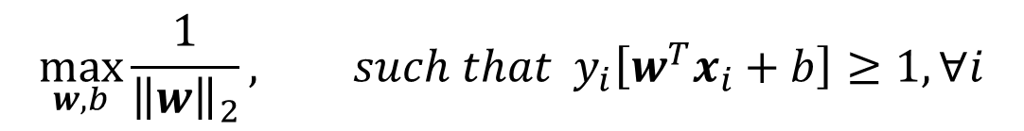
SVM: max margin formulation for separable data
Assuming separable training data, we thus want to solve:
This is equivalent to
Given our geometric intuition, SVM is called a max margin (or large margin) classifier. The constraints are called large margin constraints
$$\max_{w,b}{\frac{1}{{\left\|w\right\|}_{2}}}, such that y_{i}\left[w^{T}x_{i}+b\right]≥1, ∀i$$
$$\min_{w,b}{\frac{1}{2}{\left\|w\right\|}_{2}^{2}}$$
$$s.t. y_{i}\left[w^{T}x_{i}+b\right]≥1, ∀i$$

Slide 28

How to solve this problem?
This is a convex quadratic program: the objective function is quadratic in w
$$\min_{w,b}{\frac{1}{2}{\left\|w\right\|}_{2}^{2}}$$
$$s.t. y_{i}\left[w^{T}x_{i}+b\right]≥1, ∀i$$

Slide 29
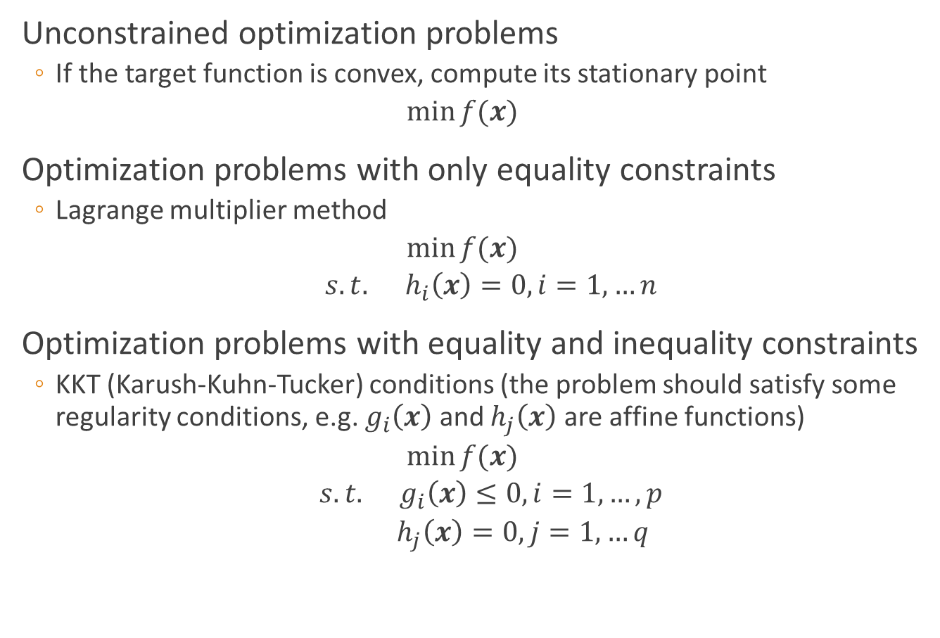
Review: Optimization problems
Unconstrained optimization problems
If the target function is convex, compute its stationary point
$$\min{f(x)}$$
Optimization problems with only equality constraints
Lagrange multiplier method
$$\min{f(x)}$$
$$s.t. h_{i}\left(x\right)=0, i=1,…n$$
Optimization problems with equality and inequality constraints
KKT (Karush-Kuhn-Tucker) conditions (the problem should satisfy some regularity conditions, e.g. $g_{i}\left(x\right)$ and $h_{j}\left(x\right)$ are affine functions)
$$\min{f(x)}$$
$$s.t. g_{i}\left(x\right)≤0, i=1,…,p$$
$$h_{j}\left(x\right)=0, j=1,…q$$

Slide 30
Review: Optimization problems
If f(x), g(x), and h(x) are all linear functions (respect to x), the optimization problem is called linear programming
If f(x) is a quadratic function, g(x) and h(x) are all linear functions, the optimization problem is called quadratic programming
If f(x), g(x), and h(x) are all nonlinear functions, the optimization problem is called nonlinear programming

Slide 31


KKT conditions
Necessary conditions Suppose that the objective function $f$ and the constraint functions $g_{i}$ and $h_{j}$ are continuously differentiable at a point $x^{∗}$. If $x^{∗}$ is a local optimum and the optimization problem satisfies some regularity conditions, then there exist constants $μ_{i} (i=1,…,p)$ and $λ_{j} (j=1,..,q)$, called KKT multipliers, such that
$$∇f\left(x^{∗}\right)+\sum_{i=1}^{p}{μ_{i}∇g_{i}(x^{∗})}+\sum_{j=1}^{q}{λ_{j}∇h_{j}(x^{∗})}=0$$
$$g_{i}\left(x^{∗}\right)≤0,i=1,…,p;$$
$$h_{j}\left(x^{∗}\right)=0, j=1,…,q$$
$$μ_{i}≥0; μ_{i}g_{i}\left(x^{∗}\right)=0, i=1,…,p$$
Notes:
KKT条件第一项是说最优点x∗必须满足所有等式及不等式限制条件, 也就是说最优点必须是一个可行解, 这一点自然是毋庸置疑的. 第二项表明在最优点x∗, ∇f必须是∇gi和∇hj的线性組合, μi和λj都叫作拉格朗日乘子. 所不同的是不等式限制条件有方向性, 所以每一个μi都必须大于或等于零, 而等式限制条件没有方向性，所以λj没有符号的限制, 其符号要视等式限制条件的写法而定.

Slide 32

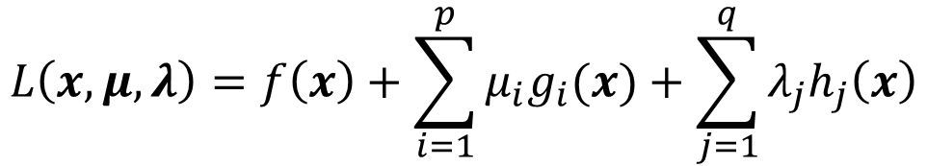


KKT conditions
Define the generalized Lagrangian
Let
The optimization problem becomes
It’s called the primal problem
$$L\left(x,μ,λ\right)=f\left(x\right)+\sum_{i=1}^{p}{μ_{i}g_{i}(x)}+\sum_{j=1}^{q}{λ_{j}h_{j}\left(x\right)}$$
$$z\left(x\right)=\max_{μ_{i}≥0,λ_{i}}{L(x,μ,λ)}$$
$$z\left(x\right)=\left\{\begin{aligned}\begin{matrix}f\left(x\right), & if x satisfies primal constraints\end{matrix} \\ \begin{matrix}∞, & otherwise\end{matrix} \end{aligned}\right.$$
$$\min_{x}{z(x)}=\min_{x}{\max_{μ_{i}≥0,λ_{i}}{L(x,μ,λ)}}$$

Slide 33



KKT conditions
It’s dual problem:
If and only if $x^{∗},μ^{∗},λ^{∗}$ satisfy KKT conditions, they are the solution of the primal and its dual problems, and
$$\max_{μ_{i}≥0,λ_{i}}{\min_{x}{L(x,μ,λ)}}≤\min_{x}{\max_{μ_{i}≥0,λ_{i}}{L(x,μ,λ)}}$$
$$\max_{μ_{i}≥0,λ_{i}}{\min_{x}{L(x,μ,λ)}}=\min_{x}{\max_{μ_{i}≥0,λ_{i}}{L(x,μ,λ)}}$$

Slide 34



KKT conditions
The steps of solving the optimization problem with equality and inequality constraints
$$\min{f(x)}$$
$$s.t. g_{i}\left(x\right)≤0, i=1,…,p$$
$$h_{j}\left(x\right)=0, j=1,…q$$
Construct the Lagrangian function
Solve the problem $\min_{x}{L(x,μ,λ)}$ using Lagrange multiplier method;
Substitute $x$ in $L(x,μ,λ)$using $μ,λ$;
Solve the problem $\max_{μ_{i}≥0,λ_{i}}{L(μ,λ)}$ using SMO algorithm.
$$L\left(x,μ,λ\right)=f\left(x\right)+\sum_{i=1}^{p}{μ_{i}g_{i}(x)}+\sum_{j=1}^{q}{λ_{j}h_{j}(x)}$$

Slide 35


KKT conditions
Example
$$\min_{x}{f\left(x\right)=x_{1}^{2}+x_{2}^{2}}$$
$$s.t. h\left(x\right)=x_{1}−x_{2}−2=0$$
$$g\left(x\right)={\left(x_{1}−2\right)}^{2}+x_{2}^{2}−1≤0$$

Slide 36





KKT conditions
Construct Lagrangian function
The primal problem is
It’s dual problem is
$$L\left(x,α,β\right)=\left(x_{1}^{2}+x_{2}^{2}\right)+α\left[{\left(x_{1}−2\right)}^{2}+x_{2}^{2}−1\right]+β(x_{1}−x_{2}−2)$$
$$\min_{x}{\max_{α≥0,β}{L(x,α,β)}}$$
$$\max_{α≥0,β}{\min_{x}{L(x,α,β)}}$$
$$\frac{∂L}{∂x_{1}}=0$$
$$\frac{∂L}{∂x_{2}}=0$$
$$\left\{\begin{aligned} x_{1}=\frac{4α−β}{2α+2} \\ x_{2}=\frac{β}{2α+2} \end{aligned}\right.$$
$$\left\{\begin{aligned} β+2x_{1}+α\left(2x_{1}−4\right)=0 \\ 2x_{2}−β+2αx_{2}=0 \end{aligned}\right.$$

Slide 37


KKT conditions
Construct Lagrangian function
The primal problem is
It’s dual problem is
$$L\left(x,α,β\right)=\left(x_{1}^{2}+x_{2}^{2}\right)+α\left[{\left(x_{1}−2\right)}^{2}+x_{2}^{2}−1\right]+β(x_{1}−x_{2}−2)$$
$$\min_{x}{\max_{α≥0,β}{L(x,α,β)}}$$
$$\max_{α≥0,β}{\min_{x}{L(x,α,β)}}$$
$$L\left(x,α,β\right)=L\left(α,β\right)=−\frac{β^{2}+4β+2α^{2}−6α}{2(α+1)}$$
$$\max_{α≥0,β}{L(α,β)}$$

Slide 38


KKT conditions
Construct Lagrangian function
The primal problem is
It’s dual problem is
$$L\left(x,α,β\right)=\left(x_{1}^{2}+x_{2}^{2}\right)+α\left[{\left(x_{1}−2\right)}^{2}+x_{2}^{2}−1\right]+β(x_{1}−x_{2}−2)$$
$$\min_{x}{\max_{α≥0,β}{L(x,α,β)}}$$
$$\max_{α≥0,β}{\min_{x}{L(x,α,β)}}$$
SMO algorithm
$$\frac{∂L}{∂α}=−\frac{2α^{2}+4α−β^{2}−4β−6}{2{\left(α+1\right)}^{2}}=0$$
$$\frac{∂L}{∂β}=\frac{2β+4}{2(α+1)}=0$$
$$\left\{\begin{aligned} α=\sqrt{2}−1 (>0) \\ β=−2 \end{aligned}\right.$$

Slide 39




How to solve this problem?
Solve the problem using KKT conditions
Construct Lagrange function $L(w,b,α)$:
where $α=\left(α_{1};α_{2};…;α_{n}\right);α_{i}≥0$
$$\min_{w,b}{\frac{1}{2}{\left\|w\right\|}_{2}^{2}}$$
$$s.t. y_{i}\left[w^{T}x_{i}+b\right]≥1, ∀i$$
$$L\left(w,b,α\right)=\frac{1}{2}{\left\|w\right\|}_{2}^{2}+\sum_{i=1}^{n}{α_{i}\left[1−y_{i}\left(w^{T}x_{i}+b\right)\right]}$$
$$\frac{∂L}{∂w}=0$$
$$\frac{∂L}{∂b}=0$$
$$w=\sum_{i=1}^{n}{α_{i}y_{i}x_{i}},0=\sum_{i=1}^{n}{α_{i}y_{i}}$$

Slide 40



How to solve this problem?
Dual problem $\max_{α} L(α)$:
$$\max_{α}{\sum_{i=1}^{n}{α_{i}}−\frac{1}{2}\sum_{i=1}^{n}{\sum_{j=1}^{n}{α_{i}α_{j}y_{i}y_{j}x_{i}^{T}x_{j}}}}$$
$$s.t. \sum_{i=1}^{n}{α_{i}y_{i}}=0,$$
$$α_{i}≥0, i=1,…,n$$
$$f\left(x\right)=w^{T}x+b=\sum_{i=1}^{n}{α_{i}y_{i}x_{i}^{T}x}+b$$

Slide 41

How to solve this problem?
KKT conditions:
$$\left\{\begin{aligned}\begin{aligned}α_{i}\left[1−y_{i}\left(w^{T}x_{i}+b\right)\right]=0 \\ 1−y_{i}\left(w^{T}x_{i}+b\right)≤0 \\ α_{i}≥0\end{aligned} \\ \sum_{i=1}^{n}{α_{i}y_{i}}=0\end{aligned}\right.$$

Slide 42


How to solve this problem?
SMO algorithm
We have $α_{i}y_{i}+α_{j}y_{j}=−\sum_{k≠i,j}{α_{k}y_{k}}=c$
Repeat until convergence {
Select some pair $α_{i}$ and $α_{j}$ to update next (using a heuristic that tries to pick the two that will allow us to make the biggest progress towards the global minimum)
Reoptimize $L\left(α\right)$ with respect to $α_{i}$ and $α_{j}$, while holding all the other $α_{k}$’s $(k≠i,j)$ fixed
}

Slide 43



How to solve this problem?
How to determine b?
Noticed that for any support vector $(x_{s},y_{s})$, there is $y_{s}f\left(x_{s}\right)=1$, i.e.
Any support vector can be chosen to solve the above equation
More often we compute b using the following equation
$$y_{s}\left(\sum_{i∈S}{α_{i}y_{i}x_{i}^{T}x_{s}}+b\right)=1$$
$$b=\frac{1}{\left|S\right|}\sum_{i∈S}{(y_{s}−α_{i}y_{i}x_{i}^{T}x_{s})}$$

Slide 44

Kernel function: Motivation
What if training samples cannot be linearly separated in its feature space?

Slide 45

Kernel function: Motivation
Imagine that this dataset is merely a 2-D version of the “true” dataset that lives in $ℝ^{3}$
The $ℝ^{3}$ dataset is easily linearly separable by a hyperplane. Thus, provided that we work in this $ℝ^{3}$ space, we can train a linear SVM classifier

Slide 46

Kernel function: Motivation
However, we are given the dataset in $ℝ^{2}$. The challenge is to find a transformation $φ\left(x\right): ℝ^{2}→ℝ^{3}$, such that the transformed dataset is linearly separable in $ℝ^{3}$
In this example, $φ\left([x_{1},x_{2}]\right)=[x_{1},x_{2},x_{1}^{2}+x_{2}^{2}]$

Slide 47

Kernel function: Motivation
Assuming we have such a transformation $φ$ , the new classification pipeline is as follows.
1. Transform the training set $X$ to $X^{′}$ with $φ$.
2. Train a linear SVM on $X^{′}$ to get classifier $f_{SVM}$.
3. At test time, a new example $\tilde{x}$ will first be transformed to $φ\left(\tilde{x}\right)$. The output class label is then determined by $f_{SVM}\left(φ\left(\tilde{x}\right)\right)=w^{T}φ\left(\tilde{x}\right)+b$
This is exactly the same as the train/test procedure for regular linear SVMs, but with an added data transformation via $φ$

Slide 48

Kernel function: Motivation
Notes:
In Figure 6, note that the hyperplane learned in R^3 is nonlinear when projected back to R^2. Thus, we have improved the expressiveness of the Linear SVM classifier by working in a higher-dimensional space.

Slide 49

Kernel function: Motivation
A dataset D that is not linearly separable in $ℝ^{N}$ (input space) may be linearly separable in a higher-dimensional space $ℝ^{M}$ (feature space), where M > N.
If we have a transformation $φ$ that lifts the dataset D to a higher-dimensional $D^{′}$ such that $D^{′}$ is linearly separable, then we can train a linear SVM on $D^{′}$ to find a decision boundary $w$ that separates the classes in $D^{′}$.
Projecting the decision boundary $w$ found in $ℝ^{M}$ back to the original space $ℝ^{N}$ will yield a nonlinear decision boundary.
This means that we can learn nonlinear SVMs while still using the original Linear SVM formulation!

Slide 50



Kernel function: Motivation
Suppose the hyperplane (decision boundary) in the feature space is $f\left(x\right)=w^{T}φ\left(x\right)+b$
Similar to the previous results, we can have
$$\min_{w,b}{\frac{1}{2}{\left\|w\right\|}_{2}^{2}}$$
$$s.t. y_{i}\left[w^{T}φ(x_{i})+b\right]≥1, ∀i$$

Slide 51


Kernel function: Motivation
Suppose the hyperplane (decision boundary) in the feature space is $f\left(x\right)=w^{T}φ\left(x\right)+b$
Similar to the previous results, we can have
It’s dual problem is
$$\min_{w,b}{\frac{1}{2}{\left\|w\right\|}_{2}^{2}}$$
$$s.t. y_{i}\left[w^{T}φ(x_{i})+b\right]≥1, ∀i$$
$$\max_{α}{ \sum_{i=1}^{n}{α_{i}}−\frac{1}{2}\sum_{i=1}^{n}{\sum_{j=1}^{n}{α_{i}α_{j}y_{i}y_{j}φ{\left(x_{i}\right)}^{T}φ(x_{j})}}}$$
$$s.t. \sum_{i=1}^{n}{α_{i}y_{i}}=0,$$
$$α_{i}≥0, i=1,…,n$$

Slide 52

Kernel function: Motivation
Such scheme looks attractive
However, consider the computational consequences of increasing the dimensionality
If M grows very quickly with respect to N (e.g. $M∈O(2^{N})$), then learning SVMs via dataset transformations will incur serious computational and memory problems!
For example: a quadratic kernel (implicitly) performs the transformation $φ\left(x\right)=$
If $x={\left[x_{1},x_{2}\right]}^{T}$, this transformation adds three additional dimensions $ℝ^{2}→ℝ^{5}$
$$[x_{n}^{2},…,x_{1}^{2}, \sqrt{2}x_{n}x_{n−1},…,\sqrt{2}x_{n}x_{1},\sqrt{2}x_{n−1}x_{n−2},…,\sqrt{2}x_{n−1}x_{1},…,\sqrt{2}x_{2}x_{1},\sqrt{2c}x_{n},…,\sqrt{2}cx_{1},c]$$
Notes:
The scheme described so far is attractive due to its simplicity: we only modify the inputs to a 'vanilla' linear SVM.

Slide 53


Kernel function
If only there exists a function $K(x,y)$ such that
$K\left(x_{i},x_{j}\right)=\left\langle φ\left(x_{i}\right),φ(x_{j})\right\rangle =φ{\left(x_{i}\right)}^{T}φ(x_{j})$
Then the problem can be written as
$$\max_{α}{ \sum_{i=1}^{n}{α_{i}}−\frac{1}{2}\sum_{i=1}^{n}{\sum_{j=1}^{n}{α_{i}α_{j}y_{i}y_{j}K(x_{i},x_{j})}}}$$
$$s.t. \sum_{i=1}^{n}{α_{i}y_{i}}=0,$$
$$α_{i}≥0, i=1,…,n$$

Slide 54



Kernel function
Solve the problem and we have
$K(⋅,⋅)$ is called a kernel function
$φ\left(x\right)→K(⋅,⋅)$
What if we don’t explicitly have the form of $φ\left(x\right)$?
$$w=\sum_{i=1}^{n}{α_{i}y_{i}φ(x_{i})}$$
$$f\left(x\right)=w^{T}φ\left(x\right)+b$$
$$=\sum_{i=1}^{n}{α_{i}y_{i}φ{\left(x_{i}\right)}^{T}φ(x)}+b$$
$$=\sum_{i=1}^{n}{α_{i}y_{i}K(x,x_{i})}+b$$

Slide 55


Kernel function
Mercer’s Theorem
A symmetric function $K\left(x,y\right)$ can be expressed as an inner product
$$K\left(x,y\right)=\left\langle φ\left(x\right),φ(y)\right\rangle$$
for some $φ$ if and only if $K\left(x,y\right)$ is positive semidefinite, i.e.
$$\int{K\left(x,y\right)g\left(x\right)g\left(y\right)dxdy}≥0, ∀g$$
or, equivalently:
is positive semi-definite for any collection $\{x_{1},x_{2},…,x_{n}\}$
$$\left[\begin{matrix}\begin{aligned}K(x_{1},x_{1}) \\ K(x_{2},x_{1})\end{aligned} & \begin{aligned}⋯ \\ ⋯\end{aligned} & \begin{aligned}K(x_{1},x_{n}) \\ K(x_{2},x_{n})\end{aligned} \\ ⋮ & ⋱ & ⋮ \\ K(x_{n},x_{1}) & ⋯ & K(x_{n},x_{n})\end{matrix}\right]$$
Kernel matrix

Slide 56

Kernel function
As long as a symmetric function’s kernel matrix is psd, it can be used as a kernel function.
In fact, for any psd kernel matrix, there always exists a mapping function $φ(x)$.
A kernel function K implicitly defines a feature space called Reproducing Kernel Hilbert Space (RHKS)
Notes:
https://blog.csdn.net/haolexiao/article/details/72171523

Slide 57

Kernel function
If the form of $φ\left(x\right)$ is not explicitly known, it’s hard to determine a suitable kernel function
How to choose a kernel function?
Popular Kernels
Linear Kernel: $K\left(x_{i},x_{j}\right)=x_{i}^{T}x_{j}$
Polynomial Kernel: $K\left(x_{i},x_{j}\right)={\left(x_{i}^{T}x_{j}\right)}^{d}$
Radial Basis Function (RBF) Kernel: $K\left(x_{i},x_{j}\right)=exp⁡(−\frac{{\left\|x_{i} −x_{j}\right\|}^{2}}{2σ^{2}})$
Sigmoid Kernel: $K\left(x_{i},x_{j}\right)=\tanh{(βx_{i}^{T}x_{j}+θ)}$
Kernels obtained through combination of other kernels
$γ_{1}K_{1}+γ_{2}K_{2}$
$K_{1}⊗K_{2}\left(x,z\right)=K_{1}\left(x,z\right)K_{2}(x,z)$
$K\left(x,z\right)=g\left(x\right)K\left(x,z\right)g(z)$

Slide 58
Kernel function
Unfortunately, choosing the “correct” kernel is a nontrivial task, and may depend on the specific task at hand.
No matter which kernel you choose, you will need to tune the kernel parameters to get good performance from your classifier.
Popular parameter-tuning techniques include K-Fold Cross Validation

Slide 59



SVM for non-separable data
SVM formulation for separable data
Non-separable setting: In practice our training data will not be separable. What issues arise with the optimization problem above when data is not separable?
For every w there exists a training point $x_{i}$ such that
There is no feasible $\left(w,b\right)$ as at least one of our constraints is violated!
$$\min_{w,b}{ \frac{1}{2}{\left\|w\right\|}_{2}^{2}}$$
$$s.t. y_{i}\left[w^{T}φ(x_{i})+b\right]≥1, ∀i$$
$$y_{i}\left[w^{T}φ(x_{i})+b\right]<0$$

Slide 60




SVM for non-separable data
Constraints in separable setting
Constraints in non-separable setting
Idea: modify our constraints to account for non-separability!
Now our target function becomes
$ℓ_{0/1}$ is called “0/1 loss function”
$$y_{i}\left[w^{T}φ(x_{i})+b\right]≥1, ∀i$$
$$\min_{w,b}{ \frac{1}{2}{\left\|w\right\|}_{2}^{2}+C\sum_{i}{ℓ_{0/1}(y_{i}\left[w^{T}φ(x)+b\right]−1)}}$$
$$ℓ_{0/1}\left(z\right)=\left\{\begin{matrix}1 & if z<0 \\ 0 & otherwise\end{matrix}\right.$$

Slide 61

SVM for non-separable data
Surrogate loss functions
Hinge loss:$ℓ_{hinge}\left(z\right)=max⁡(0,1−z)$
Exponential loss: $ℓ_{exp}\left(z\right)=exp⁡(−z)$
Logistic loss: $ℓ_{log}\left(z\right)=log⁡(1+exp⁡(−z))$

Slide 62


Hinge loss
Definition: Assume $y=\left\{−1, 1\right\}$ and the decision rule is $h\left(x\right)=sign(f(x))$ with $f\left(x\right)=w^{T}x+b$,
Intuition
No penalty if raw output, $f(x)$, has same sign and is far enough from decision boundary (i.e., if ‘margin’ is large enough)
Otherwise pay a growing penalty, between 0 and 1 if signs match, and greater than one otherwise
Convenient shorthand
$$ℓ_{hinge}\left(f\left(x\right),y\right)=\left\{\begin{matrix}0 & if yf\left(x\right)≥1 \\ 1−yf(x) & otherwise\end{matrix}\right.$$
$$ℓ_{hinge}\left(f\left(x\right),y\right)=\max\left(0,1−yf\left(x\right)\right)={\left(1−yf\left(x\right)\right)}_{+}$$

Slide 63

Hinge loss
Upper-bound for 0/1 loss function (black line)
We use hinge loss is a surrogate to 0/1 loss – Why?
Hinge loss is convex, and thus easier to work with (though it’s not differentiable at kink)

Slide 64
Hinge loss
Other surrogate losses can be used, e.g., exponential loss for Adaboost (in blue), logistic loss (not shown) for logistic regression
Hinge loss less sensitive to outliers than exponential (or logistic) loss
Logistic loss has a natural probabilistic interpretation
We can greedily optimize exponential loss (Adaboost)

Slide 65

Primal formulation of support vector machines
Minimizing the total hinge loss on all the training data
We balance between two terms (the loss and the regularizer)
$$\min_{w,b}{ \frac{1}{2}{\left\|w\right\|}_{2}^{2}+C\sum_{i}{\max\left(0,1−y_{i}\left[w^{T}φ(x_{i})+b\right]\right)}}$$

Slide 66



Primal formulation of support vector machines
Define slack variables $ξ_{i}≥\max\left(0,1−y_{i}f(x_{i})\right)$
Since $c≥\max\left(a,b\right)⟺c≥a,c≥b$, the optimization becomes
What is the role of C?
$$\min_{w,b,ξ_{i}}{ \frac{1}{2}{\left\|w\right\|}_{2}^{2}+C\sum_{i}{ξ_{i}}}$$
$$s.t. \max\left(0,1−y_{i}\left[w^{T}φ(x_{i})+b\right]\right)≤ξ_{i}, ∀i$$
$$\min_{w,b,ξ_{i}}{ \frac{1}{2}{\left\|w\right\|}_{2}^{2}+C\sum_{i}{ξ_{i}}}$$
$$s.t. y_{i}\left[w^{T}φ(x_{i})+b\right]≥1−ξ_{i}, ∀i$$
$$ξ_{i}≥0, ∀i$$
Notes:
User-defined hyperparameter
Trades off between the two terms in our objective

Slide 67


How to solve this problem?
This is a convex quadratic program: the objective function is quadratic in w and linear in $ξ$ and the constraints are linear (inequality) constraints in w, b and $ξ_{i}$.
$$\min_{w,b,ξ_{i}}{ \frac{1}{2}{\left\|w\right\|}_{2}^{2}+C\sum_{i}{ξ_{i}}}$$
$$s.t. y_{i}\left[w^{T}φ(x_{i})+b\right]≥1−ξ_{i}, ∀i$$
$$ξ_{i}≥0, ∀i$$

Slide 68




How to solve this problem?
Construct a Lagrange function $L(w,b,α,ξ,μ)$:
$$L\left(w,b,α,ξ,μ\right)=\frac{1}{2}{\left\|w\right\|}_{2}^{2}+C\sum_{i=1}^{n}{ξ_{i}}$$
$$+\sum_{i=1}^{n}{α_{i}(1−ξ_{i}−y_{i}(w^{T}φ(x_{i})+b))}−\sum_{i=1}^{n}{μ_{i}ξ_{i}}$$
$$\frac{∂L}{∂w}=0$$
$$\frac{∂L}{∂b}=0$$
$$\frac{∂L}{∂ξ_{i}}=0$$
$$w=\sum_{i=1}^{n}{α_{i}y_{i}φ(x_{i})}$$
$$0=\sum_{i=1}^{n}{α_{i}y_{i}}$$
$$C=α_{i}+μ_{i}$$

Slide 69


How to solve this problem?
Original problem
Dual problem
$$\min_{w,b,ξ_{i}}{ \frac{1}{2}{\left\|w\right\|}_{2}^{2}+C\sum_{i}{ξ_{i}}}$$
$$s.t. y_{i}\left[w^{T}φ(x_{i})+b\right]≥1−ξ_{i}, ∀i,$$
$$ξ_{i}≥0,∀i$$
$$\max_{α}{ \sum_{i=1}^{n}{α_{i}}−\frac{1}{2}\sum_{i=1}^{n}{\sum_{j=1}^{n}{α_{i}α_{j}y_{i}y_{j}φ{\left(x_{i}\right)}^{T}φ(x_{i})}}}$$
$$s.t. \sum_{i=1}^{n}{α_{i}y_{i}}=0,$$
${0≤α}_{i}≤C, i=1,…,n$

Slide 70

How to solve this problem?
KKT conditions of dual problem
$$\left\{\begin{aligned}\begin{aligned}α_{i}\left[1−ξ_{i}−y_{i}\left(w^{T}x_{i}+b\right)\right]=0 \\ 1−ξ_{i}−y_{i}\left(w^{T}x_{i}+b\right)≤0 \\ α_{i}≥0 \\ ξ_{i}≥0 \end{aligned} \\ μ_{i}≥0 \\ μ_{i}ξ_{i}=0\end{aligned}\right.$$

Slide 71
Meaning of “support vectors” in SVMs
The SVM solution is only determined by a subset of the training samples
These samples are called support vectors
All other training points do not affect the optimal solution, i.e., if remove the other points and construct another SVM classifier on the reduced dataset, the optimal solution will be the same

Slide 72

Visualization of how training data points are categorized
Support vectors are highlighted by the dotted orange lines

Slide 73

Regularization
Generalized optimization problem
$$\min_{f}{Ω\left(f\right)+C\sum_{i}^{n}{ℓ(f\left(x_{i}\right),y_{i})}}$$

